Slide 1

CSC4630 Course PROJECT. GROUP 31: Supermarket Point of Sale (POS) System Inception PRESENTATION.

Slide 2
Deliverables
Introduction
Problem statements and Business Objectives
Scope
High-Level Requirements %10 use case
Risk List and Feasibility study
Iteration Plan

Slide 3
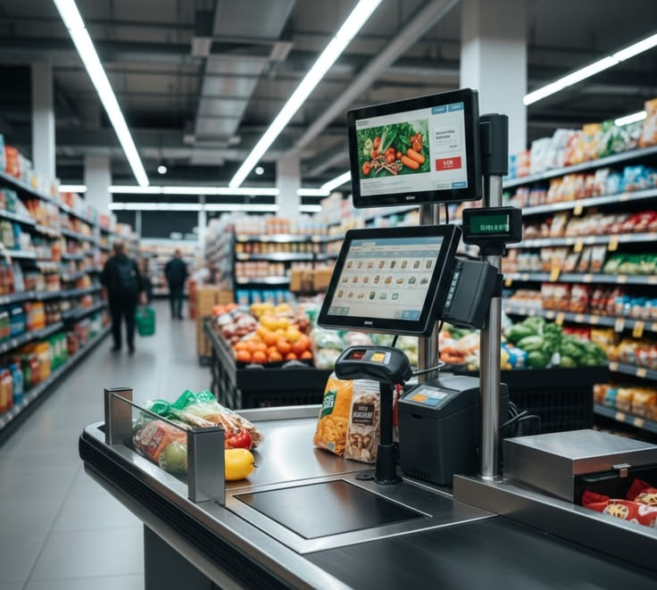
UNIFIED PROCESS PHASE 1(INCEPTION )

Slide 4
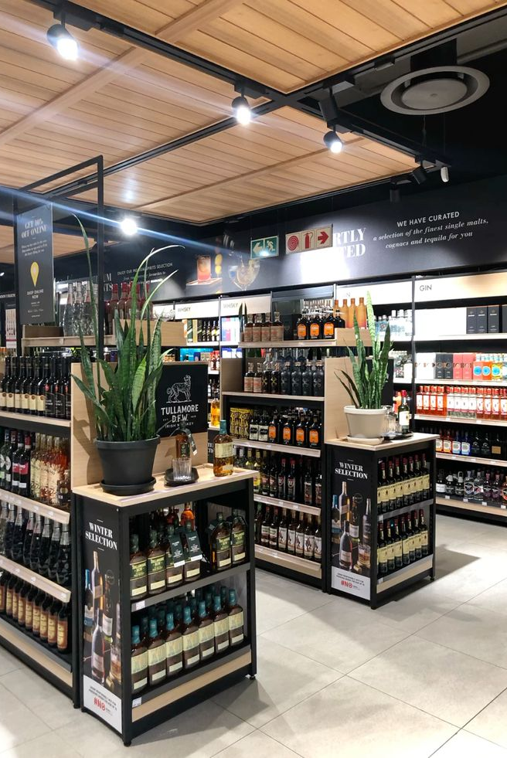
CONTENT
Introduction
Common high-level goals
Problem Statements and Business Objectives
Scope
High-Level Requirements %10 use case
Risk List and Feasibility study
Iteration Plan

Slide 5
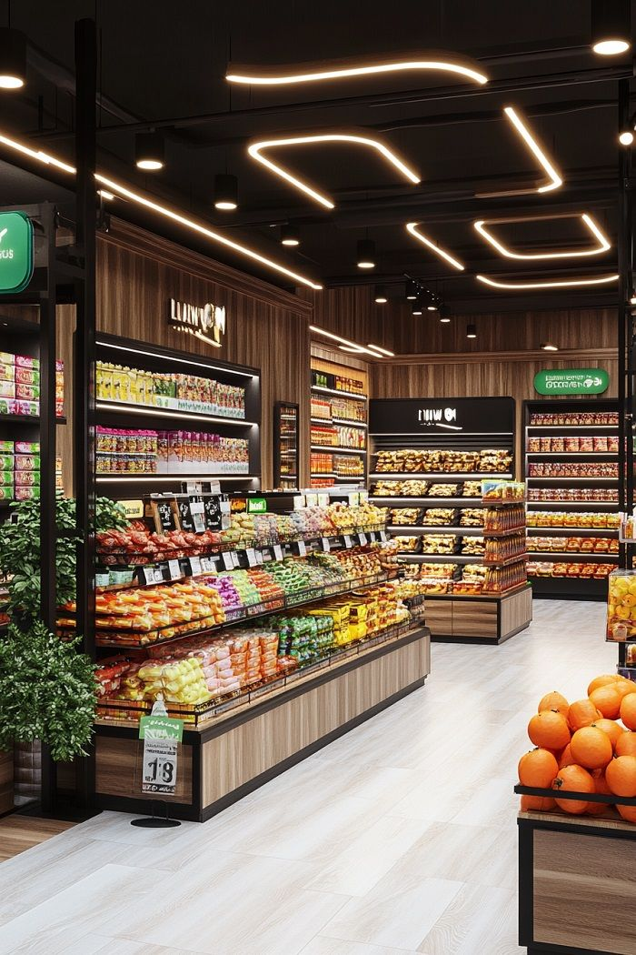
Supermarket (POS) SYSTEM

Slide 6
INTRODUCTION
This project aims to develop a modern, reliable, and user-friendly Point of Sale (POS) system specifically for supermarkets in our region. The system will help cashiers process sales quickly, support different payment methods, keep inventory accurate in real time, and give store managers simple daily reports. By replacing old, slow, or error-prone checkout systems, the new POS will improve customer experience, reduce mistakes, and help supermarkets run more efficiently.

Slide 7
Common high-level goals
Fast and accurate checkout – cut queue times during peak hours
Real-time inventory integration – know stock levels instantly
Support multiple payment types – cash, cards, mobile money
Reliable operation – keep working offline during power cuts or network drops

Slide 8
Problem Statements and business objectives.

Slide 9
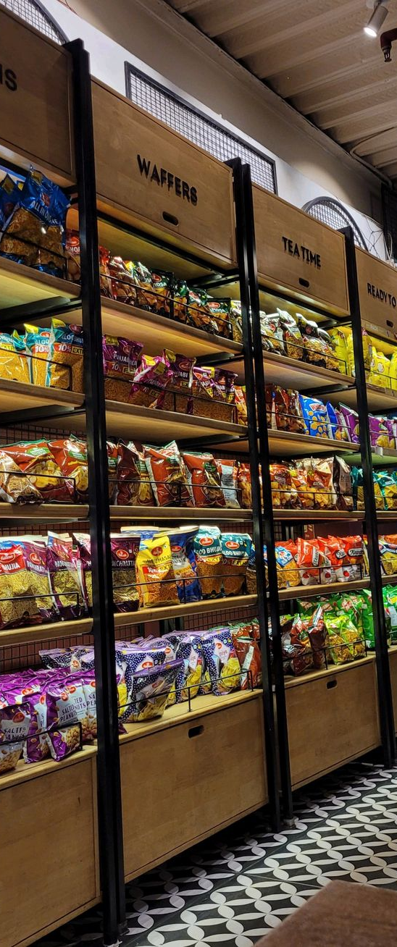
Problem statements
Long queues at peak hours: customer frustration, abandoned carts, lost sales
Stock-outs on perishables + overstocking: wasted goods, lost revenue, poor cash flow
Frequent power cuts & network drops: halted sales, revenue loss, damaged customer trust
Limited options (mostly cash): missed mobile money/card customers, slower checkout

Slide 10
BUSINESS Objectives ​
Provide store managers with accurate, real-time sales and inventory reports at end of day
Make the system easy to learn and use so new cashiers can be trained in under 2 hours
Increase overall store efficiency and reduce manual work (e.g., no more paper stock counts)
Reduced average checkout time by at least 30% during peak hours to improve customer satisfaction \
Eliminate pricing and stock quantity errors through real-time system update
Enable multiple payment methods (cash, debit/credit cards, mobile money, QR codes) to serve more customers

Slide 11
Scope
Allow cashiers to process customer purchases (scan items, calculate total, apply basic discounts)
Accept multiple payment types: cash, debit/credit card, mobile money (e.g., Airtel Money, MTN MoMo, Zamtel Kwacha)
Issue printed receipts and (optionally) digital receipts via SMS/email
Update inventory levels in real time after each sale
Support basic user roles: Cashier (daily use) and Manager (view reports, add/remove products)
Generate simple daily/weekly sales summary reports

Slide 12
High level requirements: 10% use case
 | Use Case | Actor | Description
1 | Process Sale | Cashier | Scan items, Calculate total, Updates inventory and prints out a receipt.​
2 | Handle Return | Cashier/Customer​ | Handle product returns and refunds. Update of inventory for return
3 | Process Discount | Cashier/ Manager | Add Promotional discounts
4 | View Sale Summary | Cashier/ Manager | Daily or weekly Sales totals calculated report on inventory status.
5 | Manage Inventory | Manager | Update stock, Inspect products
6

Slide 13
Risk list and feasibility
Technical risk: Integrating multiple payment methods (cash, card, mobile money like MTN/Airtel) may have API or simulation issues. This passes as a high risk because payments are core.
Business risk: Requirements change if supermarket managers want extra features (e.g., discounts, loyalty) after we start. This could cause scope creep.
Team risk: Limited experience with chosen tech stack (e.g., Java + database) or Git for CI. Might delay in Construction.
Hardware simulation risk: Mocking scanner/printer might not feel realistic in demo. Hence affecting user feedback in Transition.
Time risk: 15-week deadline is tight for full implementation + tests. Need strict iteration timeboxes.

Slide 14
ITERATION Plan
Week | UP Phase | Iteration(s) | Focus
1-2 | Inception | - | Discover core requirements, define vision, identify risks, plan iterations (high-level feasibility).
3-5 | Elaboration | Iteration 1 | Build core architecture, detail key 30% use cases, domain model, SSDs, proof-of-concept (address high risks like payments & inventory first).
6-8 | Elaboration | Iteration 2 | Complete remaining use cases, refine design, UI prototypes, mitigate remaining risks (architecture-centric).
9-12 | Construction | Iteration 3-4 | Implement prioritized features incrementally, add unit/integration tests, continuous integration (Git), defect tracking (feature-complete system).
13-14 | Transition | Iteration 5 | Beta testing, user feedback, performance/security fixes, final documentation & user manual.
15 | Transition | Final | Live demo of key scenarios, final report (lessons learned, UP reflection), submit code repository.

Slide 15
THANK YOU

